Slide 1
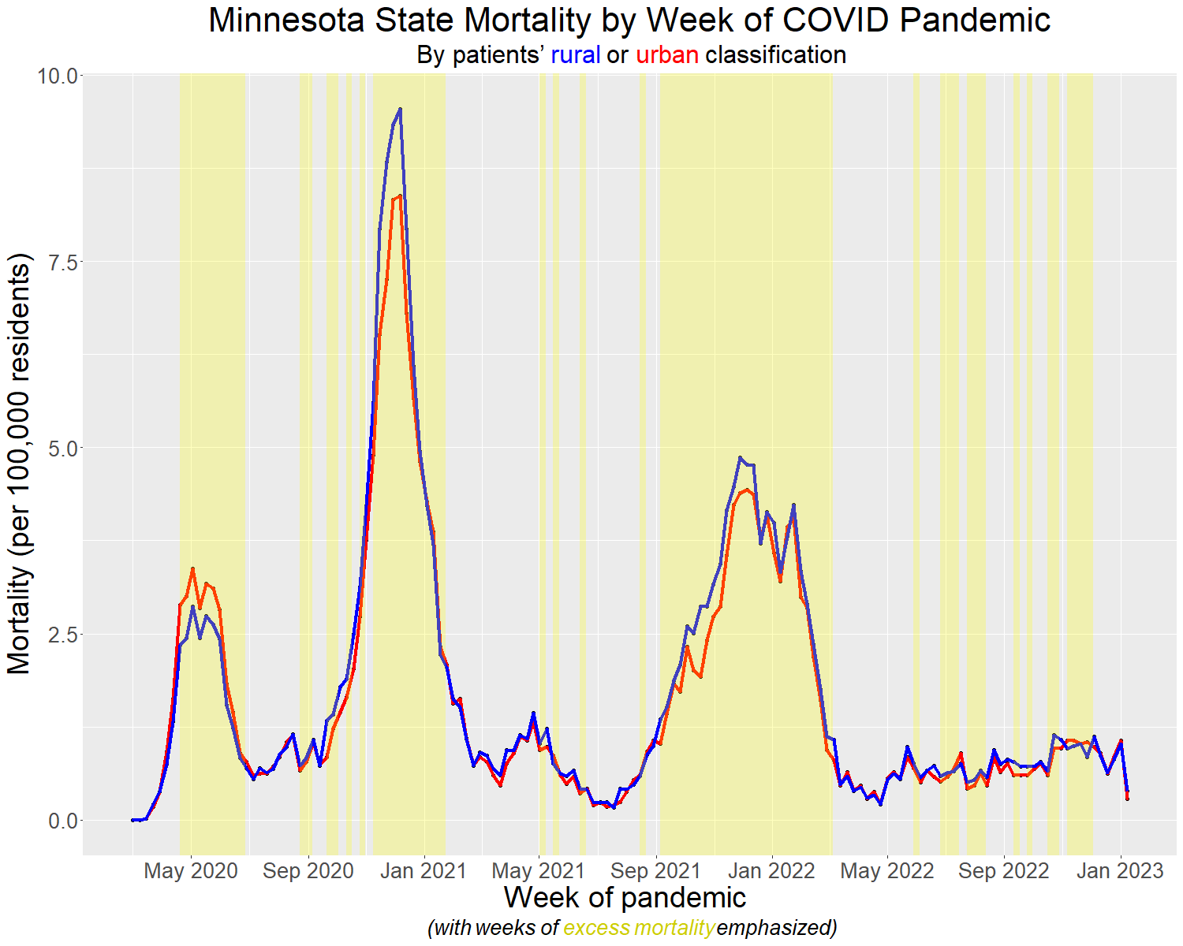
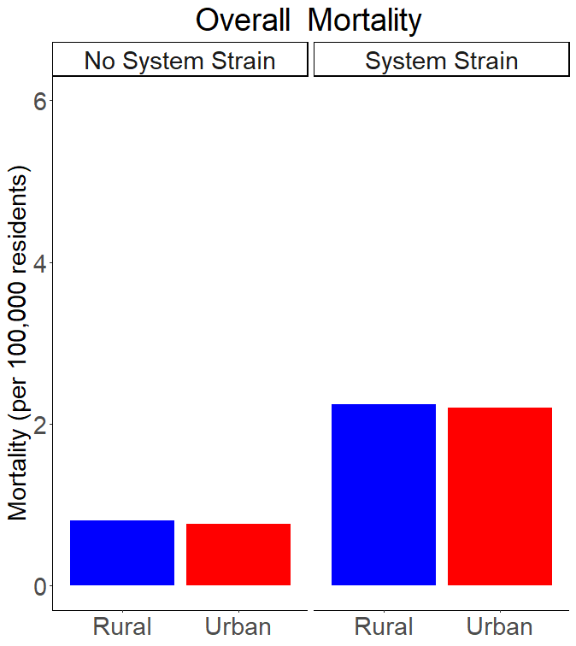
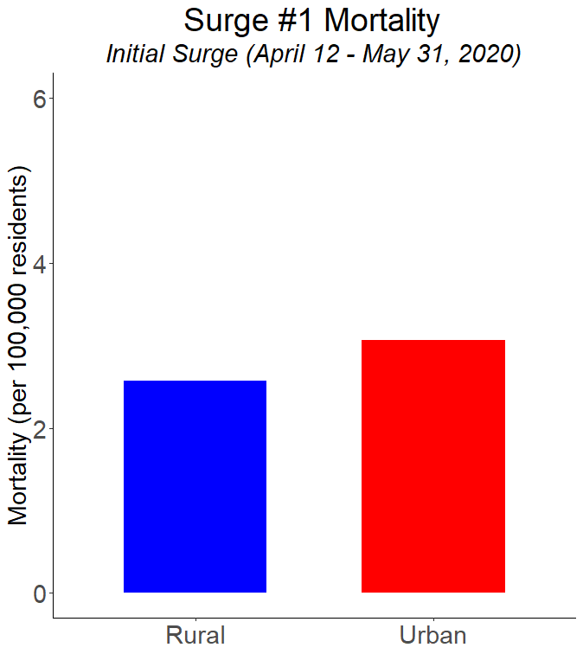
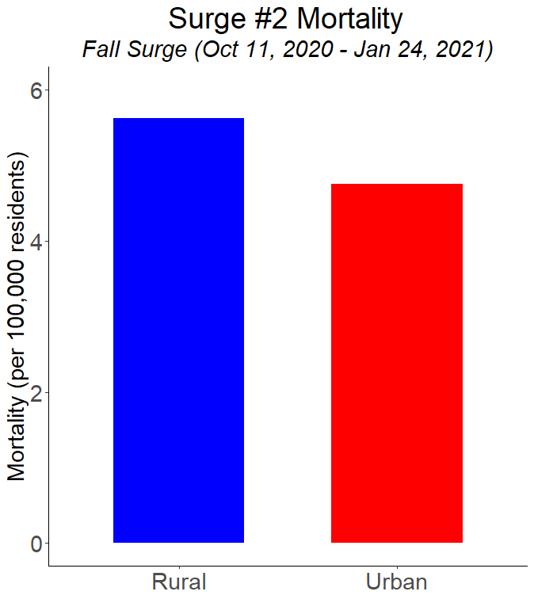
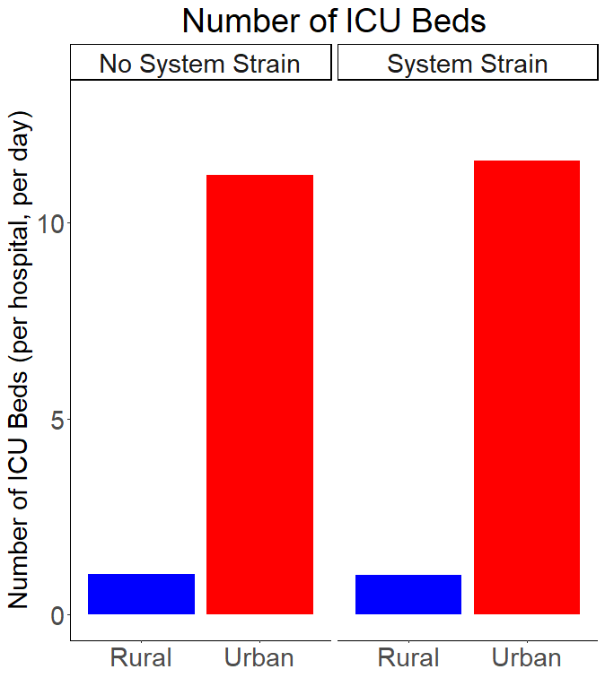
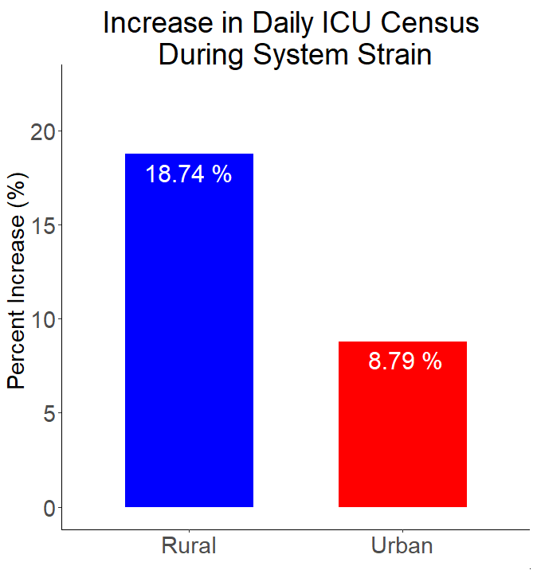

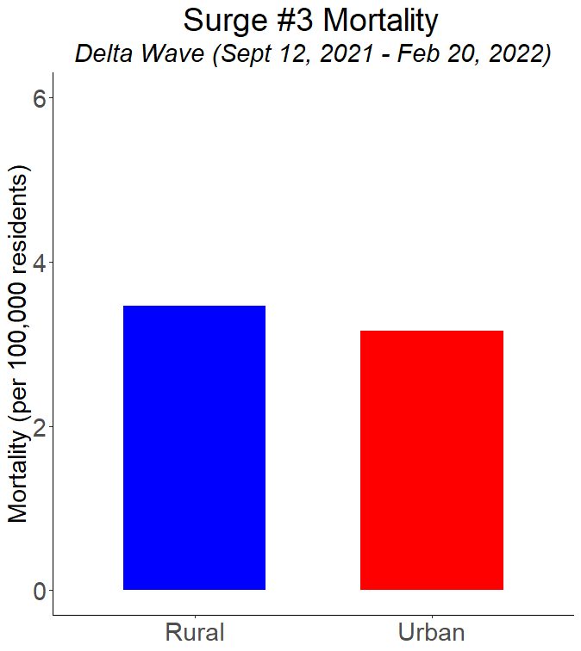

Rural and Urban Intensive Care Unit Resource Availability and Mortality During the COVID-19 Pandemic in Minnesota
R.W. Starcher, T.J. Adam
University of Minnesota
Introduction
COVID-19 strained healthcare systems, negatively impacting intensive care unit (ICU) access and outcomes.¹ With only 1% of ICU beds in rural areas, rural patients face additional geographic disparities that may worsen the effects of strain.² It is unknown whether rural and urban ICUs responded differently to COVID-19 system strain and whether rural populations experienced higher mortality.
Mortality
Discussion
There were 3 major COVID surges in Minnesota, each associated with periods of excess mortality. The initial surge saw significantly greater mortality in urban areas, but the subsequent surges affected rural populations more – albeit not significantly so.
Urban ICUs had more beds, but neither urban nor rural ICUs had greater capacity during surges.
Rural and urban ICU censuses were higher and mortality was greater during surges. While rural ICU census was low, it had a greater relative increase during times of strain, suggesting some downstream effects from system strain.
P<0.001
Rural
P<0.001
Urban
Period of Excess Mortality (strain)
P=0.7296
P=0.6135
2.74
2.56
0.81
0.77
Mortality was higher during periods of system strain for both groups, but there was no difference in mortality rates when directly comparing rural vs. urban.
Hypothesis
Urban ICUs – and not rural ICUs -- in Minnesota expanded ICU capacity during periods of greatest system strain, but rural patients had higher mortality rates as a downstream effect of strain.
P=0.008
2.58
3.06
3.06
Conclusion
System strain during the COVID pandemic in Minnesota was associated with a disproportionately larger increase in rural ICU census compared to urban ICU census without mobilization of greater resources or significant differences in mortality.
Methods
Minnesota hospital utilization and mortality data were extracted from public datasets^{3–5} from March 1, 2020, through January 8, 2023. Federal rural definitions⁶ determined rurality. Weeks with excess mortality were proxies for times of strain.⁴ In cases where sample sizes were too small, the mean ranges of potential values were imputed and incorporated within rurality zones. Two-tailed t-testing compared means. Data management was performed with Python (version 3.10.6) and statistical analyses with RStudio (R version 4.2.2).
Resource Availability
P=0.5971
5.73
5.11
P<0.001
P<0.001
P=0.028
5.11
11.38
P=0.1192
11.63
References
1. Bravata DM, Perkins AJ, Myers LJ, et al. Association of Intensive Care Unit Patient Load and Demand With Mortality Rates in US Department of Veterans Affairs Hospitals During the COVID-19 Pandemic. JAMA Netw Open. 2021;4(1):e2034266. doi:10.1001/jamanetworkopen.2020.34266
2. Halpern NA, Tan KS. United States Resource Availability for COVID-19. 5/12/2020. (Version 3):16.
3. Minnesota Department of Health. Mortality Data COVID-19. Published online January 19, 2023. Accessed January 20, 2023. https://www.health.state.mn.us/diseases/coronavirus/stats/death.html
4. National Center for Health Statistics. Excess Deaths Associated with COVID-19. Published online January 18, 2023. Accessed January 20, 2023. https://data.cdc.gov/NCHS/Excess-Deaths-Associated-with-COVID-19/xkkf-xrst/
5. HealthData.gov. COVID-19 Reported Patient Impact and Hospital Capacity by Facility. Published online January 16, 2023. Accessed January 20, 2023. https://healthdata.gov/Hospital/COVID-19-Reported-Patient-Impact-and-Hospital-Capa/anag-cw7u
6. Office of Management and Budget V. 2010 Standards for Delineating Metropolitan and Micropolitan Statistical Areas. Fed Regist. 2010;75(123).
Results
Of the 131 weeks, 62 (47%) had excess mortality and were deemed periods of system strain. Deaths totaled 28,170 (with 15,984, or 56.7%, being rural individuals).
P=0.3417
P=0.275
1.03
1.01
3.47
3.16
Urban hospitals had more ICU beds than rural hospitals, but neither group had significantly greater bed numbers during periods of strain.
During times of strain, rural hospitals saw a greater percent increase from baseline ICU census; however, their baseline census was less than 1, on average.
Notes:
My project was looking at the effects of system strain on rural and urban hospitals in Minnesota in order to better understand how ICU resources were distributed and whether patients in certain areas experienced disparities in mortality.
The idea came from understanding that with only 1% of ICU beds in rural areas nationwide, patients in rural areas potentially face greater access limitations when ICU resources are made otherwise more scarce – as they were during the COVID pandemic.
So, we used publicly available datasets to answer these questions. Weeks with excess mortality were used as proxies for times of system strain. Metropolitan Statistical Areas signified rural status at the county level for both patient-level mortality data and hospital location.
Results
Data ranged from March 1, 2020, through January 8, 2023 – making up 131 weeks with 47% having strain. There were a total of 28,170 deaths recorded during this period – 56.7% of them were in rural patients.
So, looking at the graphs, the timeline up top shows rural mortality rates in blue and urban in red. Weeks with strain are highlighted in yellow. As you can see visually, there were 3 major surges in mortality and all 3 of these corresponded to several weeks with excess mortality.
On the right is a series of bar charts showing the observed mortality rates in rural and urban areas. First, on top, you can see (unsurprisingly) that mortality was significantly lower when there was no system strain compared to when there was. Given that we defined system strain as periods of excess mortality, this is more just a confirmation of the difference. What is more relevant to our study, however, is comparing the rural (in blue) to the urban (in red). In both cases of strain and cases without strain, there was no difference between the two groups, signifying no mortality disparities overall.
However, if you look back at the timeline, you can see that during each of the 3 surge periods, there seems to be a difference where the rural and urban lines separate. In the first surge, it appears to have an urban (red) predominance; whereas, in the 2 subsequent surge periods, mortality seems to have a rural (blue) predominance. Because of this, we used change point analysis to identify the periods of change and evaluated mortality within each of these periods separately.
These results are the 3 subsequent bar plots on the right. Surge #1 was the initial case surge in Minnesota and spanned the period April 12 – May 31, 2020. During this time, urban mortality rates were significantly higher than rural mortality rates. This is fitting with the initial patterns of COVID cases across the US at the same time period where urban zones were universally hit much harder with initial infections.
The second surge occurred during the first fall/winter period (October 11, 2020 – January 24, 2021). This was the time period during which mortality rates were the highest overall. There was a rural predominance as we saw on the time plot, but it was not statistically significant.
And finally, the third surge occurred when the Delta variant hit, was the only surge to occur after widespread vaccinations, and lasted the longest of the 3 surges (from September 12, 2021 through February 20, 2022). Mortality again was slightly higher in rural areas, but not significantly so.
So, the final questions of our study revolved around resource availability – particularly to what extent did hospitals increase ICU capacity in rural and urban areas and how much did their average daily census change.
On the bottom left, you can see the number of ICU beds reported per hospital, per day during times without strain as well as times with strain. The red bar shows the urban numbers, which you can clearly see were significantly higher than the rural (blue) numbers in both time periods – with about a 10-fold disparity. Rural hospitals had no capacity increase during periods of strain; whereas urban hospitals had a slight increase in bed numbers, but not significantly so.
And so lastly, we looked at reported ICU census numbers, reported in the final bar graph. For this, we adjusted the census numbers of the strained time period to baseline non-strained census numbers. With only (on average) a single ICU bed in rural areas, the absolute increase in census was minimal, but the percent increase was over 18% -- significantly greater than the nearly 9% increase in urban census.
Conclusion
This raised a few potential explanations. One: That during normal non-pandemic operations, rural ICUs may have greater capacity to handle more patients than they typically do – without increasing mortality.
An alternative explanation is that during times of system strain, increases in urban ICU censuses eventually reaches a cap which may then lead to an overflowed backlog throughout the system, causing downstream effects throughout the transfer networks that this study was unable to detect. Given personal observations of long waitlists causing delays in transfers and outlying hospitals keeping patients they were ill equipped to care for, we suspect that this is the more likely explanation.
Moving forward, further research is needed to better understand how transfer delays impact broader clinical outcomes including length of stay, ventilator days, and hospital complication rates, among others; as well as how patient-level variables may impact transfer decisions in a strained system.

